Slide 1
K-Means Clustering

Slide 2
Agenda
• What is Clustering?
• Why and When to Use K-Means
• Introduction to K-Means
• How It Works
• Choosing K
• Applications (incl. ADAS)
• Basic Problem Example
• Pros & Cons
• Conclusion

Slide 3
What is Clustering?
• Unsupervised technique to group similar data
• No predefined labels
• Useful for pattern discovery and data segmentation

Slide 4
Why and When to Use K-Means
Why Use K-Means:
• Simple and fast clustering method
• Works well when data is clearly separable
• Great for exploratory data analysis
When to Use It:
• You want to group data into K segments
• When labels are unknown
• When clusters are roughly spherical and equal in size

Slide 5
What is K-Means Clustering?
• Centroid-based clustering algorithm
• Groups data into K clusters
• Each cluster represented by the average of its points (centroid)

Slide 6
How K-Means Works (Step-by-Step)
1. Select K
2. Initialize K centroids
3. Assign each point to nearest centroid
4. Recompute centroids
5. Repeat until stable clusters

Slide 7
Choosing the Value of K
Use Elbow Method, Silhouette Score
No “perfect” K — it depends on your dataset

Slide 8
Applications of K-Means
General Use Cases:
• Customer segmentation
• Image compression
• Anomaly detection
• Document clustering
ADAS (Advanced Driver Assistance Systems):
• Lane Detection Clustering
• Object Tracking: Clustering object detections over time
• Scene Understanding: Grouping pixels into semantic regions
• Helps systems like automatic braking, lane keep assist, etc.

Slide 9
Basic K-Means Problem Example
Problem:
Group the following 6 points into 2 clusters using K-Means:
(1,1), (1.5,2), (3,4), (5,7), (3.5,5), (4.5,5)
Steps:
1. Choose K=2
2. Randomly initialize 2 centroids
3. Assign points to nearest centroid
4. Update centroids
5. Repeat until convergence

Slide 10
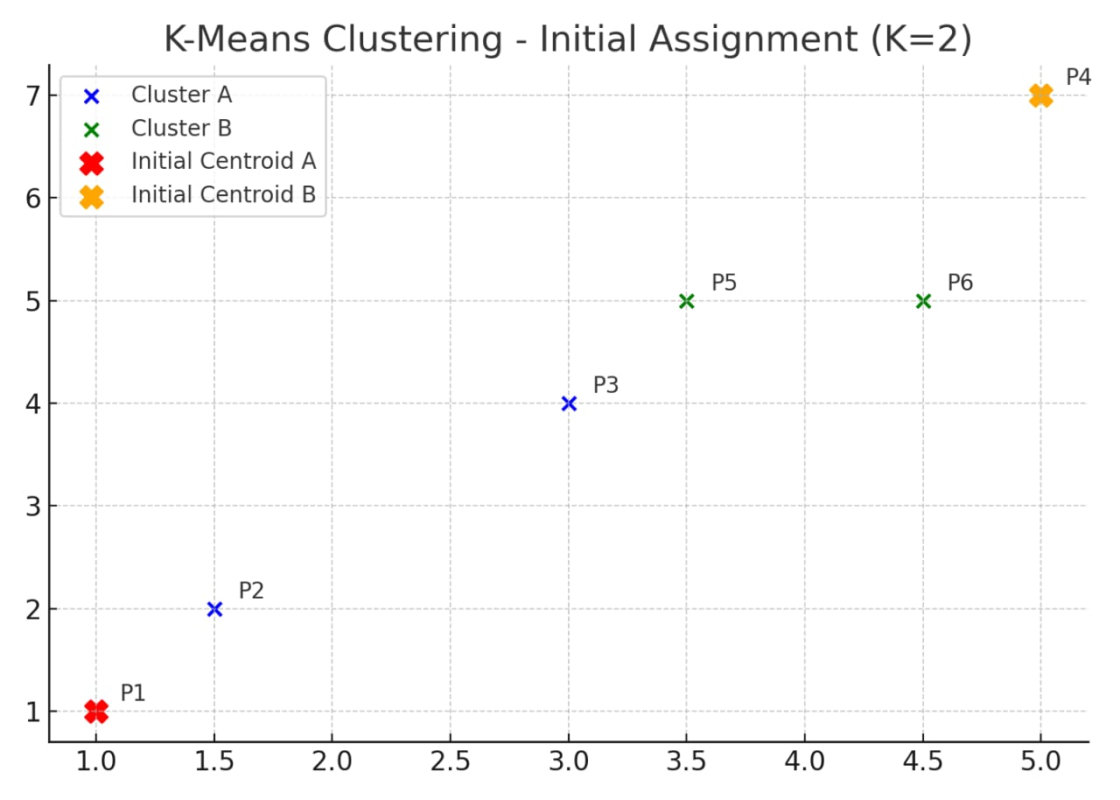

Slide 11
Step 1: Initialize Select K = 2 (two clusters). Randomly choose initial centroids: Centroid A = (1,1), Centroid B = (5,7)
Step 2: Assign Points to Nearest Centroid Using Euclidean distance, assign each point to the closest centroid:
(1,1), (1.5,2), (3,4) → Cluster A
(5,7), (3.5,5), (4.5,5) → Cluster B

Slide 12
.
Step 3: Recalculate Centroids Calculate the mean of each cluster:
New Centroid A = Mean of (1,1), (1.5,2), (3,4) = (1.83, 2.33)
New Centroid B = Mean of (5,7), (3.5,5), (4.5,5) = (4.33, 5.66)
Step 4: Repeat Reassign points based on updated centroids and recalculate again. Repeat until centroids stabilize (no further change).

Slide 13
Advantages of K-Means
• Fast and scalable
• Simple to understand
• Works well for basic clustering

Slide 14
Limitations of K-Means
• Sensitive to initial placement
• Requires K to be known
• Struggles with non-spherical clusters and outliers

Slide 15
Conclusion
• K-Means is powerful and simple
• Useful across domains including ADAS
• Ideal for quick and interpretable segmentation tasks

